Slide 1

Stocker
A stock market guidance App

Slide 2
UNDERSTAND THE DIFFERENCE BETWEEN A TRADER OR INVESTOR?
To start with, you should first understand the difference between a trader and an investor. A trader is someone who might buy stocks and might sell the same within minutes, hours, or days. An investor, on the other hand, is a long-term market participant who can hold on to his purchases for several months and even years.

Slide 3
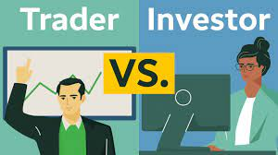
You should clearly understand the difference between the two and know what you want to be. This is because trading strategies do not work for investors and investing strategies fail to work for traders. So, pick a side at the beginning as this will work as the foundation of your stock market journey

Slide 4
UNDERSTAND THE BASICS OF THE STOCK MARKET
Once you have picked a side, the next step in how to invest in the stock market is to get the basics right. Get the basic idea of what BSE, NSE, Sensex, and Nifty are. Try to know more about what stocks are, stock market timings, who is a stockbroker, how the market moves, etc. to get a general idea about the market.

Slide 5

In the bid to make quick money, most beginners often skip learning the basics. But if you are unaware of the basics, it will not be possible for you to build your own trading/investing strategies. Spend at least a few days mastering the basics so that you actually know what to do once you get yourself a trading account.

Slide 6
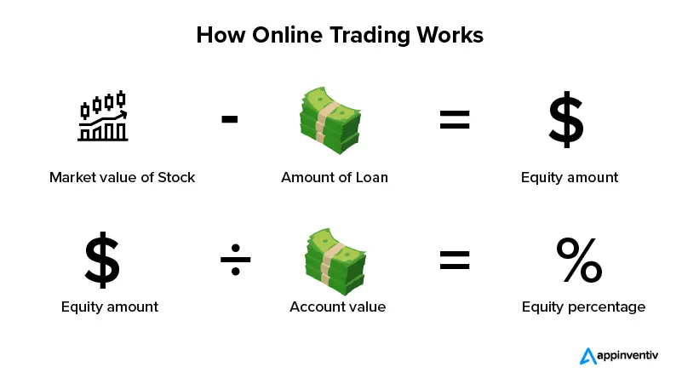

Slide 7
SELECTING A STOCKBROKER IN INDIA
One of the most important decisions that you'd be required to make at the start of your trading journey is to pick a stockbroker. There are several stock brokers in India, and the selection can be difficult for beginners. Focus on factors such as the reputation of the broker, trading portal or software, and brokerage to make a decision.

Slide 8
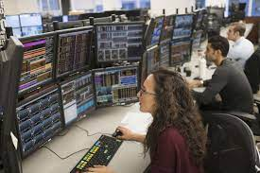
Give special attention to the brokerage as you will be required to pay it irrespective of whether you make profits or losses on a trade. The brokerage can either be a flat fee or some percentage of the trade value. This is especially important for stock traders as the brokerage of multiple trades adds up very quickly.

Slide 9
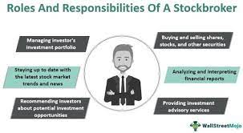

Slide 10
USE STOP LOSS ON EVERY TRADE
Check the order screen on the trading portal of your stockbroker, and you will see the stop-loss option. A stop-loss helps you reduce your losses as it lets you select a price at which your position will be automatically squared off. For instance, if you are purchasing 100 shares of SBI at Rs. 350 and expect its price to rise, you can put a stop loss at Rs. 345.

Slide 11

If at all the stock price falls, your 100 shares will be automatically squared off when it reaches Rs. 345. If you want to know how to invest in the stock market successfully, it is essential to use stop-loss on all of your trades at least in your initial days of trading. Most brokers now allow you to place a stop loss at the time you place the buy/sell order.

Slide 12
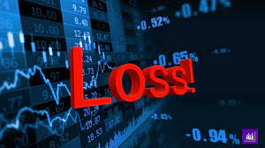


Slide 13
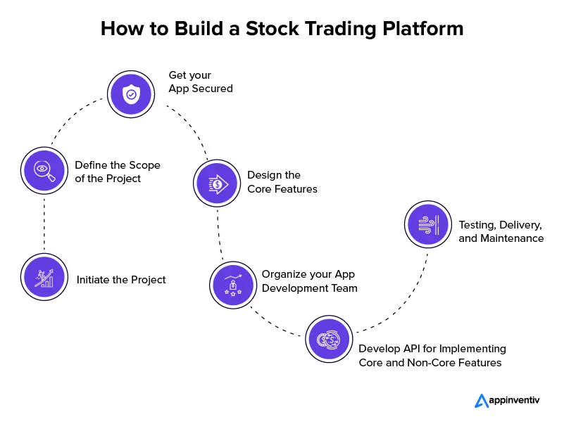
A stock trading application is an online system that allows users to easily sell, purchase and manage stocks on a trading platform. Let us have a look at how to build a stock trading app:
1. Initiate the Project
2. Define the Scope of the Project
3. Get your App Secured
4. Design the Core Features
5. Organize your App Development Team
6. Develop API for Implementing Core and Non-Core Features
7. Testing, Delivery, and Maintenance

Slide 14
Thank YOu

